Slide 1
Walmart Sales-Forecasting

Slide 2
Historical sales data are provided for 45 Walmart stores located in different regions. Each store contains a number of departments and sales data.
Walmart runs several promotional markdown events throughout the year. These markdowns precede prominent holidays, the four largest of which are the Super Bowl, Labor Day, Thanksgiving, and Christmas. The weeks including these holidays are weighted five times higher in the evaluation than non-holiday weeks.

Slide 3
The goal is to predict the department-wide sales for each department in each store.

Slide 4
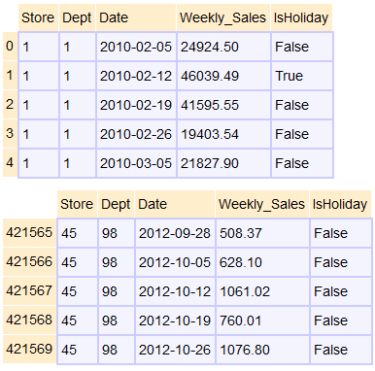
Train dataset contains approximately 3 years worth of data: 02/05/2010-10/26/2012

Slide 5
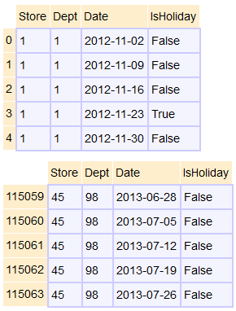
Test dataset contains 11/02/2012-07/26/2013 with no weekly sales data. Weekly_Sales Predictions will be made using the test dataset.

Slide 6
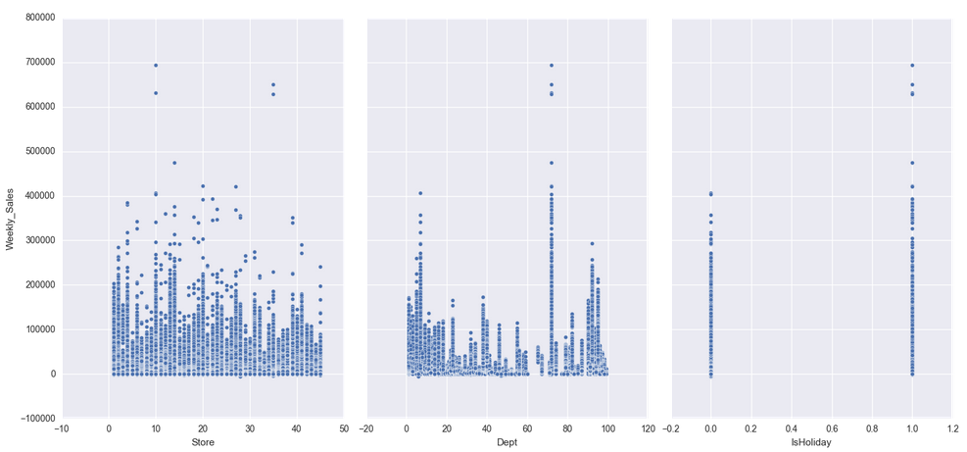
Weekly Sales
High weekly sales in store 1 and 35 , mostly in Dept 72 during the holidays.

Slide 7
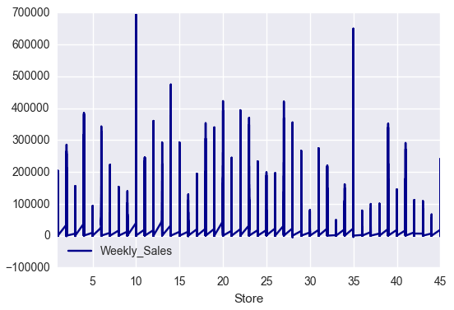
Another way of visualizing the weekly sales by store. Again, high weekly sales in store 1 and 35.

Slide 8
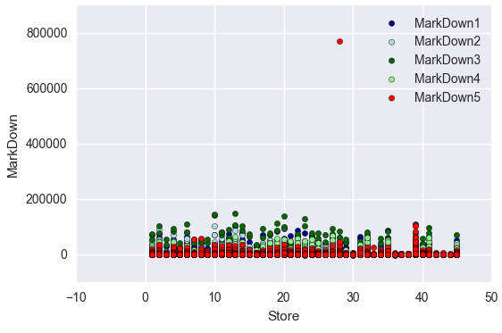
Markdowns
Outlier for MarkDown5 (771448) is on a non-holiday in Store 28. This could be an entry error. We can omit this outlier from the analysis.

